Slide 1
TCS: A new multiple sequence alignment reliability measure to estimate alignment accuracy and improve phylogenetic tree reconstruction
http://www.tcoffee.org/Packages/Stable/Latest
http://tcoffee.crg.cat/tcs
Jia-Ming Chang, Paolo Di Tommaso, and Cedric Notredame TCS: A new multiple sequence alignment reliability measure to estimate alignment accuracy and improve phylogenetic tree reconstruction, Mol Biol Evol first published online April 1, 2014, doi:10.1093/molbev/msu117
Notes:
Can we use this effect to increase modeling confidence?

Slide 2
alignment uncertainty - data
OPOSSUM
BLOSUM62
MUSSOPO
26MUSOLB
MSA
Aln1
OPOSSUM--
BLOS-UM62
Aln2
OPOSSUM--
BLO-SUM62
Landan G, Graur D (2007) Heads or Tails: A Simple Reliability Check for Multiple Sequence Alignments. Molecular Biology and Evolution 24: 1380 –1383.
Notes:
[give the idea what is alignment uncertainty]
You might listen this whole session about alignment uncertainty. In practice, how does it look like?
For example, we want to align opossum and blosum62.
Here are two alignment results. Which one is correct?
Any one for the first? the second one?
10:8. This is alignment uncertainty.
Both of them are identical good.
Here is the uncertainty part of alignment.

Slide 3
alignment uncertainty - data
Aln1
OPOSSUM--
BLOS-UM62
Aln2
OPOSSUM--
BLO-SUM62
If there are two paths
{
chooses low-road;
}
 | O | P | O | S | S | U | M
B | \ |  |  |  |  |  |  | B
L |  | \ |  |  |  |  |  | L
O |  |  | \ |  |  |  |  | O
S |  |  |  | \ | \ |  |  | S
U |  |  |  |  |  | \ |  | U
M |  |  |  |  |  |  | \ | M
6 |  |  |  |  |  |  | | | 6
2 |  |  |  |  |  |  | | | 2
 | O | P | O | S | S | U | M
Landan G, Graur D (2007) Heads or Tails: A Simple Reliability Check for Multiple Sequence Alignments. Molecular Biology and Evolution 24: 1380 –1383.
Notes:
[give the idea what is alignment uncertainty]
You might listen this whole session about alignment uncertainty. In practice, how does it look like?
For example, we want to align opossum and blosum62.
Here are two alignment results. Which one is correct?
Any one for the first? the second one?
10:8. This is alignment uncertainty.
Both of them are identical good.
Here is the uncertainty part of alignment.

Slide 4
alignment uncertainty - data
Aln1
BLOS-UM45
OPOSSUM--
BLOS-UM62
Aln2
BLO-SUM45
OPOSSUM--
BLOS-UM62
Aln3
BLO-SUM45
OPOSSUM--
BLO-SUM62
Aln4
BLOS-UM45
OPOSSUM--
BLO-SUM62
It gets worse with a multiple sequence alignment.
Telling apart Uncertainty parts of the alignment is more important than the overall accuracy.
Notes:
If we add BLOSUM45 into the previous alignments. Now, we have four ambiguous alignments.
Again! Anyone for the first? for the second? for the third? for the fourth?
5:5:5:5
This time, those five are the same persons.
You are more confusing which one you should choose.
It gets worse with multiple sequence alignment.

Slide 5
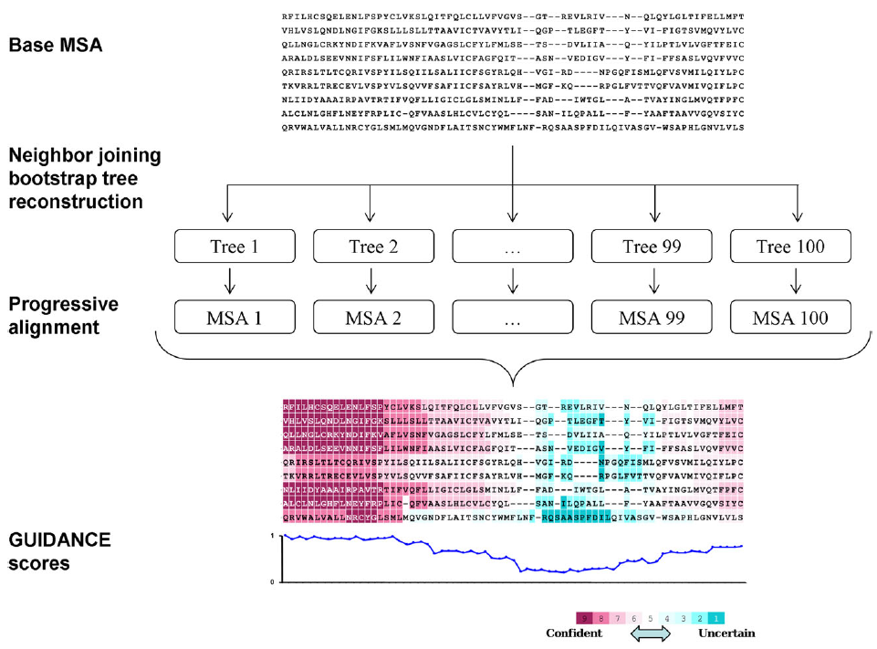
Guidance
Penn O, Privman E, Landan G, Graur D, Pupko T (2010) An alignment confidence score capturing robustness to guide tree uncertainty. Mol Biol Evol 27: 1759–1767.
Notes:
In 2010, Penn proposed Gudiance score.
They explore Guide tree spaces by bootstrap.
They compare the input MSA with those 100 alternative MSA.
Count how many time an aligned pair also appears inside those 100 MSAs.
This indicate the confidence.
As you might know, bootstrap is time consuming, Can I estimate this confidence without bootstrapping?

Slide 6
Which alignment task is difficult?
pairwise alignment
3*l²
l
l³
multiple sequence alignment
If l = 200, the second is 66 times slower than the first

Slide 7
Where are samples?
x
x
y
MSA
Pairwise alignments
consistency
y
Consistency between MSA & pairwise alignment : 0/1
How can we increase the resolution of confidence?
Notes:
show pairwsie alignments

Slide 8
Transitive relation
In mathematics, a binary relation R over a set X is transitive if whenever an element a is related to an element b, and b is in turn related to an element c, then a is also related to c.
-WikiPedia
Notes:
First of all, what is consistency?
In MSA, we find the residue x of seq A is aligned with the residue y of seq B.
Is aligned pair reliable? How about considering another intermediate sequence.
Let’s say seq I.
In the pairwise alignment, A and I, we find x is aligned with z.
In the pairwise alignment I and B, we find z is aligned with y.
We say, aligned residue pair x & y is consistent with sequence I.
Now, we have another intermediate sequence I’.
This time, x is aligned with z’ but z’ is aligned with n not y.
So, Aligned residue pair x & y is inconsistent with sequence I’.

Slide 9
Transitive relation in alignment scene
multiple sequence alignment
pairwise alignment
x
x
consistency
a
a
y
y
Notes:
First of all, what is consistency?
In MSA, we find the residue x of seq A is aligned with the residue y of seq B.
Is aligned pair reliable? How about considering another intermediate sequence.
Let’s say seq I.
In the pairwise alignment, A and I, we find x is aligned with z.
In the pairwise alignment I and B, we find z is aligned with y.
We say, aligned residue pair x & y is consistent with sequence I.
Now, we have another intermediate sequence I’.
This time, x is aligned with z’ but z’ is aligned with n not y.
So, Aligned residue pair x & y is inconsistent with sequence I’.

Slide 10
x
a
x
b
x
d
x
MSA
Pairwise alignments
y
a
y
c
y
e
y
consistency
inconsistency
inconsistency
Notes:
show pairwsie alignments

Slide 11
x
MSA
y
76
x
78
x
80
x
a
b
d
93
a
71
c
81
e
y
y
y
76
71
80
consistency
inconsistency
inconsistency
76
TCS (x,y)=
76 + 71 + 80
Notes:
show pairwsie alignments

Slide 12
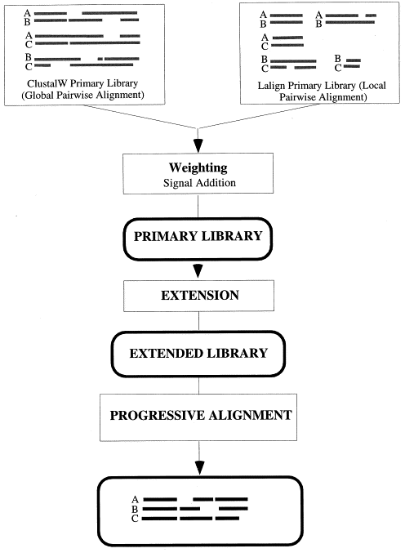

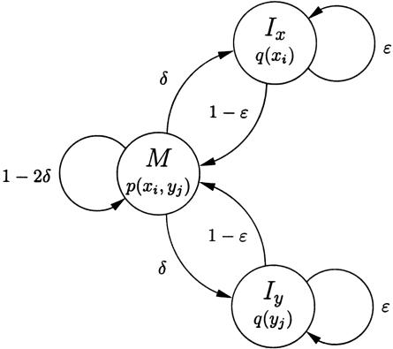



TCS_Original
TCS
TCS_FM
ProbCons biphasic pair-HMM
Library
Kalign
MUSCLE
MAFFT
Probcons: C. B. Do, M. S. P. Mahabhashyam, M. Brudno, S. Batzoglou, Genome Res (2005). MAFFT: K. Katoh, K. Misawa, K. Kuma, T. Miyata, Nucleic Acids Res., (2002).
MUSCLE: R. C. Edgar, Nucl. Acids Res. (2004). Kalign: T. Lassmann, E. L. L. Sonnhammer, BMC Bioinformatics (2005).
Notes:
In original T-Coffee, it used ClustalW and Lalign to build library.
Now, we need to teach him new tricks,
First, pair-HMM introduced by ProbCons.
It might be slow.
Another trick, FM-Coffee mode which combine three fast guys, MAFFT, MUSCLE and Kalign.
This mode is also used in Ensembl pipeline.
Those three methods can be used to build library.

Slide 13
CLUSTAL W (1.83) multiple sequence alignment
1j46_A MQ------DRVKRP---MNAFIVWSRDQRRKMALENPRMRN--SEISKQL
2lef_A MH--------IKKP---LNAFMLYMKEMRANVVAESTLKES--AAINQIL
1k99_A MKKLKKHPDFPKKP---LTPYFRFFMEKRAKYAKLHPEMSN--LDLTKIL
1aab_ GK------GDPKKPRGKMSSYAFFVQTSREEHKKKHPDASVNFSEFSKKC
: *:* :..: : * : . :.:
TCS
Residue level
Col row row TCS
1 1 2 0.762
1 1 3 0.748
1 1 4 0.741
1 2 3 0.651
1 2 4 0.677
1 3 4 0.693
2 1 3 0.562
2 1 4 0.632
2 3 4 0.526
…
T-COFFEE, Version_9.01 (2012-01-27 09:40:38)
Cedric Notredame
CPU TIME:0 sec.
SCORE=76
*
BAD AVG GOOD
*
1j46_A : 74
2lef_A : 75
1k99_A : 77
1aab_ : 72
cons : 76
1j46_A 75------4566---677777777777777777776666--7789999
2lef_A 6--------566---677777777777777777777766--7789999
1k99_A 865454445667---777788887888888888877877--7789999
1aab_ 76------5665333566676666666666666666655336789999
cons 641111113455122566777666666777777666655215689999
Alignment level
Column level

Slide 14
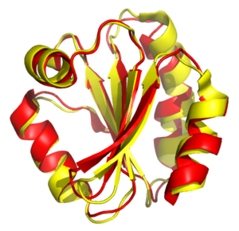
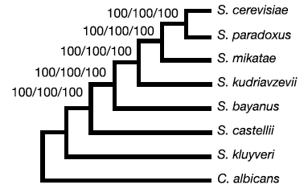
Residue level
T-COFFEE, Version_9.01 (2012-01-27 09:40:38)
Cedric Notredame
CPU TIME:0 sec.
SCORE=76
*
BAD AVG GOOD
*
1j46_A : 74
2lef_A : 75
1k99_A : 77
1aab_ : 72
cons : 76
1j46_A 75------4566---677777777777777777776666--7789999
2lef_A 6--------566---677777777777777777777766--7789999
1k99_A 865454445667---777788887888888888877877--7789999
1aab_ 76------5665333566676666666666666666655336789999
cons 641111113455122566777666666777777666655215689999
Col row row TCS
1 1 2 0.762
1 1 3 0.748
1 1 4 0.741
1 2 3 0.651
1 2 4 0.677
1 3 4 0.693
2 1 3 0.562
2 1 4 0.632
2 3 4 0.526
…
Alignment level
Column level
Structural modeling
Evolutionary modeling

Slide 15
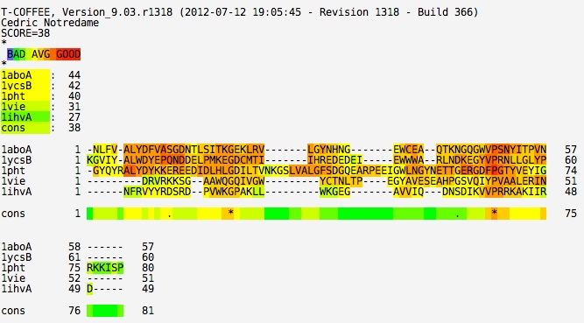
Q1: Is Transitive Consistency Score an Indicator of Accuracy?

Slide 16
Test1 - structural modeling @ residue level
BAliBASE 3, PREFAB 4
MAFFT, ClustalW, Muscle, PRANK, SATe
Seq1 …SALMLWLSARESIKREN…YPD…
Seq2 …SAYNIYVSFQ----RESA…KD…
…
Seqn
D
HoT, Guidance, TCS
L
Y
D
Score 1
L Y 100
R Q 70
D D 60
Score 2
L Y 100
D D 90
R Q 50
R
R
Notes:
First, how to quantify.
Here is a MSA, let’s focus on seq 1 and 2.
We find residue pair L is aligned with Y, R with Q, D with D.
We compare it with reference alignment.
In the reference alignment, usually structure alignment, L is also aligned with Y. D with D. but R with R.
Now, aligned residue pairs are scored by two different methods, score 1 and score 2.
Which one is better?
Let’s vote.
For score1 (no one…are you sure….), for score2? (my self hand on)
Why is score2 better than score1?

Slide 17
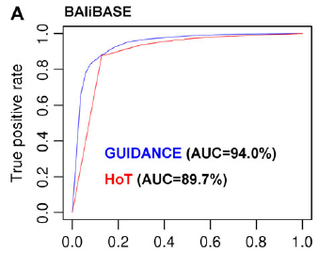
AUC measurement
Score 1
L Y 100 TP
R Q 70 FP
D D 60 TP
Score 2
L Y 100 TP
D D 90 TP
R Q 50 FP
57 citation by Google
Penn O, Privman E, Ashkenazy H, Landan G, Graur D, Pupko T: GUIDANCE: a web server for assessing alignment confidence scores. Nucleic Acids Res 2010, 38(Web Server issue):W23-28.
Penn O, Privman E, Landan G, Graur D, Pupko T: An alignment confidence score capturing robustness to guide tree uncertainty. Mol Biol Evol 2010, 27(8):1759-1767.
Landan G, Graur D: Heads or tails: a simple reliability check for multiple sequence alignments. Mol Biol Evol 2007, 24(6):1380-1383.
75 citation by Google

Slide 18
Evaluation
The Alignments are made by 3 methods
MAFFT 6.711
MUSCLE 3.8.31
ClustalW 2.1
The Alignments are evaluated with 3 methods
T-Coffee Core
Guidance
HoT
Notes:
Alignments are made by three alignment tools which are supported by Guidance.
Those alignments are evaluated with 3 score schemes, T-Coffee Core, Guidance and HoT.

Slide 19
AUC
 | MAFFT | ClustalW | MUSCLE
TCS | 94.44 | 96.46 | 94.51
Guidance | 90.28 | 87.69 | 94.51
HoT | 82.66 | 90.95 | -
PRANK | SATe
96.93 | 93.25
91.68 | -
- | -
BAliBASE SP | 0.807 | 0.714 | 0.793 | 0.765 | 0.831
PREFAB SP | 0.595 | 0.661 | 0.649 | 0.614 | 0.686
TCS | 90.81 | 89.24 | 87.96 | 92.31 | 86.77
Guidance | 85.74 | 80.64 | 85.60 | 87.34 | -
HoT | 80.30 | 83.94 | - | - | -
TCS is the most informative & the most stable measure across aligners.
Notes:
Average AUC (%) of structure correctness using TCS, HoT and GUIDANCE. SPs denotes the average similarity between evaluated MSAs and their references measured as the fraction of identical pairs (Sum-of-Pairs). The best performance is marked in bold. Measurements significantly better than all others in the same column are shown in italics. (Wilcoxon Signed-Rank Test in 0.05 significance level, by R wilcoxon.test function: paired = TRUE, alternative = “greater”) Entries with (-) indicate measurements that could not be carried out for a lack of support of the considered method for the corresponding aligner.
For BAliBASE 3, how many sets? 218 sets
I fifteen, we measure AUC by putting residue pairs from 218 data sets together. Then you get one single AUC value.
However, we find few data sets with large alignment length such that it comes out huge amount residue pairs.
Those sets might bias whole analysis.
Another AUC is average by sets.
You can see T-Coffee core has similar performance in those two measurements.
This indicate its performance is quite stable cross those 218 sets.
Then, for ClustalW, MUSCLE.
Here are their alignment accuracies in the Sum of Pair measurement.
As you can see, they are variant in accuracy.
T-Cofffee is not only good but also fast.
In conclude, T-Coffee core is the most informative & the most stable measure across aligners with diverse accuracy.

Slide 20
MAFFT
How about difficult alignment sets?
 | BAliBASE RV11 | PREFAB 0~20
SP | 0.536 | 0.465
TCS | 91.11 | 87.16
Guidance | 83.51 | 86.03
HoT | 72.63 | 81.35
How about easy alignment sets?
 | BAliBASE RV12 | PREFAB 70~100
SP | 0.888 | 0.942
TCS | 96.83 | 78.98
Guidance | 92.64 | 62.01
HoT | 78.79 | 57.96
Notes:
Let’s look individual sub-set:
First, difficult set.
MAFFT only manage to achieve less 60% SPS.
Then, easy set.
CORE is good when it’s difficult and easy.
RV11 Balibase dataset. BaliBase/RV11 is made of 38 datasests consisting of seven or more highly divergent protein sequences (<20% pair-wise identity on the reference alignment)

Slide 21
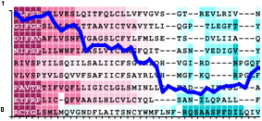
How about different library protocols?
BAliBASE | PREFAB
94.44 | 89.24
90.28 | 85.74
87.28 | 80.03
82.66 | 80.30
Time(s)*
17,244
66,368
3,093
16,449
TCS
Guidance
TCS_FM
HoT
*measured in MAFFT
Notes:
Although, FM-Coffee does not perform as good as T-Coffee Core but it is fast.
It is almost ten-times faster than Guidance.

Slide 22
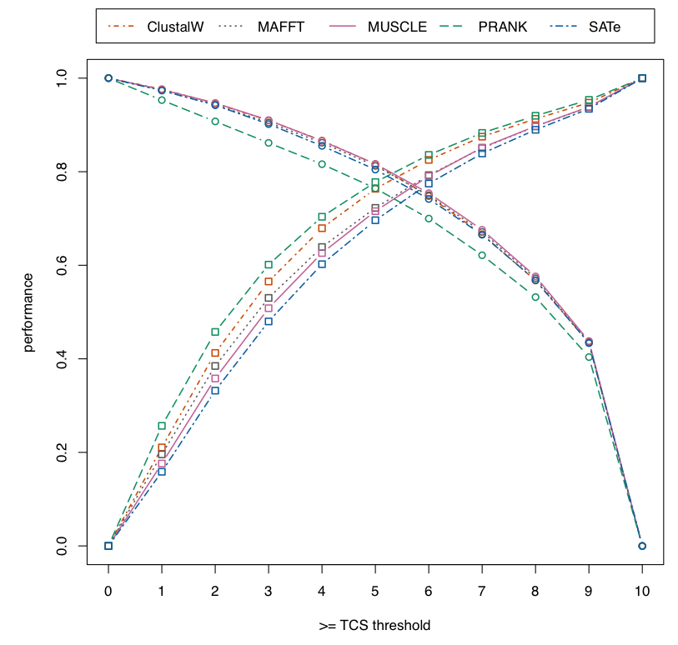
Fig. 1. Specificity and Sensitivity of the TCS indexes in structure correctness analysis for different alignments. All points correspond to measurments done by removing all residues within the target MSA having a ResidueTCS score lower or equal than the considered threshold.

Slide 23
Q2: Is Transitive Consistency Score an Indicator of good aligner?

Slide 24
Test2 - structural modeling @ alignment level
reference alignment
Guidence/TCS
S
Seq1 …SALMLWLSARESIKREN…YPD…
Seq2 …SAYNIYVSFQ----RESA…KD…
…
Seqn …SAYNIYVSAQ----RENA…KD…
SP1
confidence1
SP2
Seq1 …SALMLWLSARESIKREN…YPD…
Seq2 …SAYNIYVSF----QRESA…KD…
…
Seqn …SAYNIYVSA----QRENA…KD…
confidence2
SP1 – SP2 ? confidence1 – confidence2

Slide 25
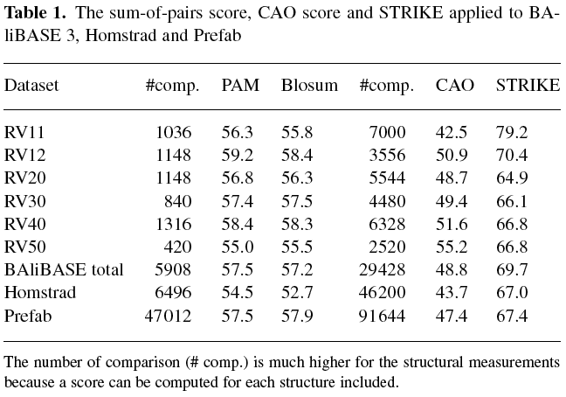
The sate of art
Kemena C, Taly JF, Kleinjung J, Notredame C: STRIKE: evaluation of protein MSAs using a single 3D structure. BIOINFORMATICS 2011, 27(24):3385-3391.

Slide 26
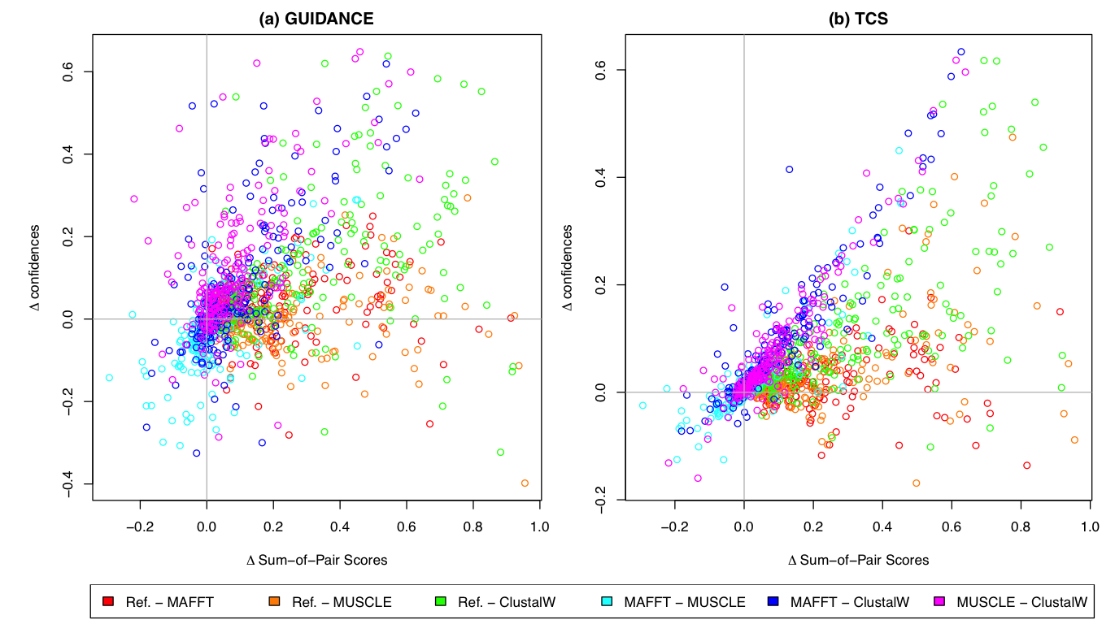
Guidance
= 71.10%
TCS
= 83.5%

Slide 27
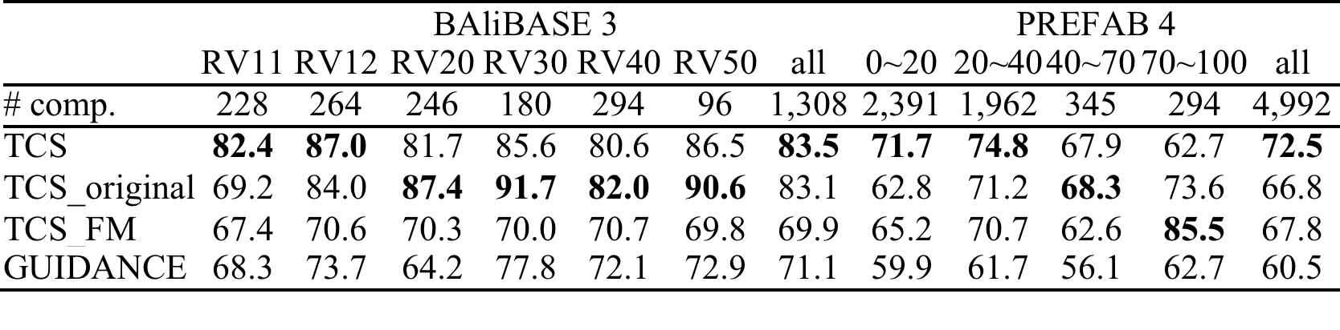
Table 4. The prediction power of overall alignment correctness by library protocols and GUDIANCE applied to BAliBASE and PREFAB. “# comp.” denotes the number of the pair alignment comparisons. The best performance is marked in bold.

Slide 28
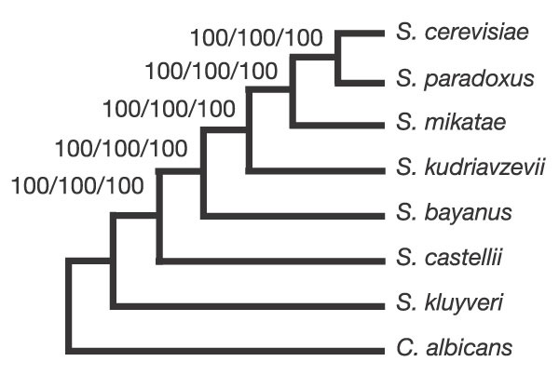
Q3:Does Transitive Consistency Score help phylogenetic reconstruction?

Slide 29
Test3 - Evolutionary Benchmark
Simulation
16 tips
32 tips
64 tips
Yeasts : 853
Seq
MAFFT
ClustalW
ProbCons PRANK
SATe
aligner
MSA
Gblocks
trimAl
wrTCS
post process
Robinson-Foulds distance
MSA
maximum likelihood
Neighboring Joining
maximum parsimony
build tree

Slide 30
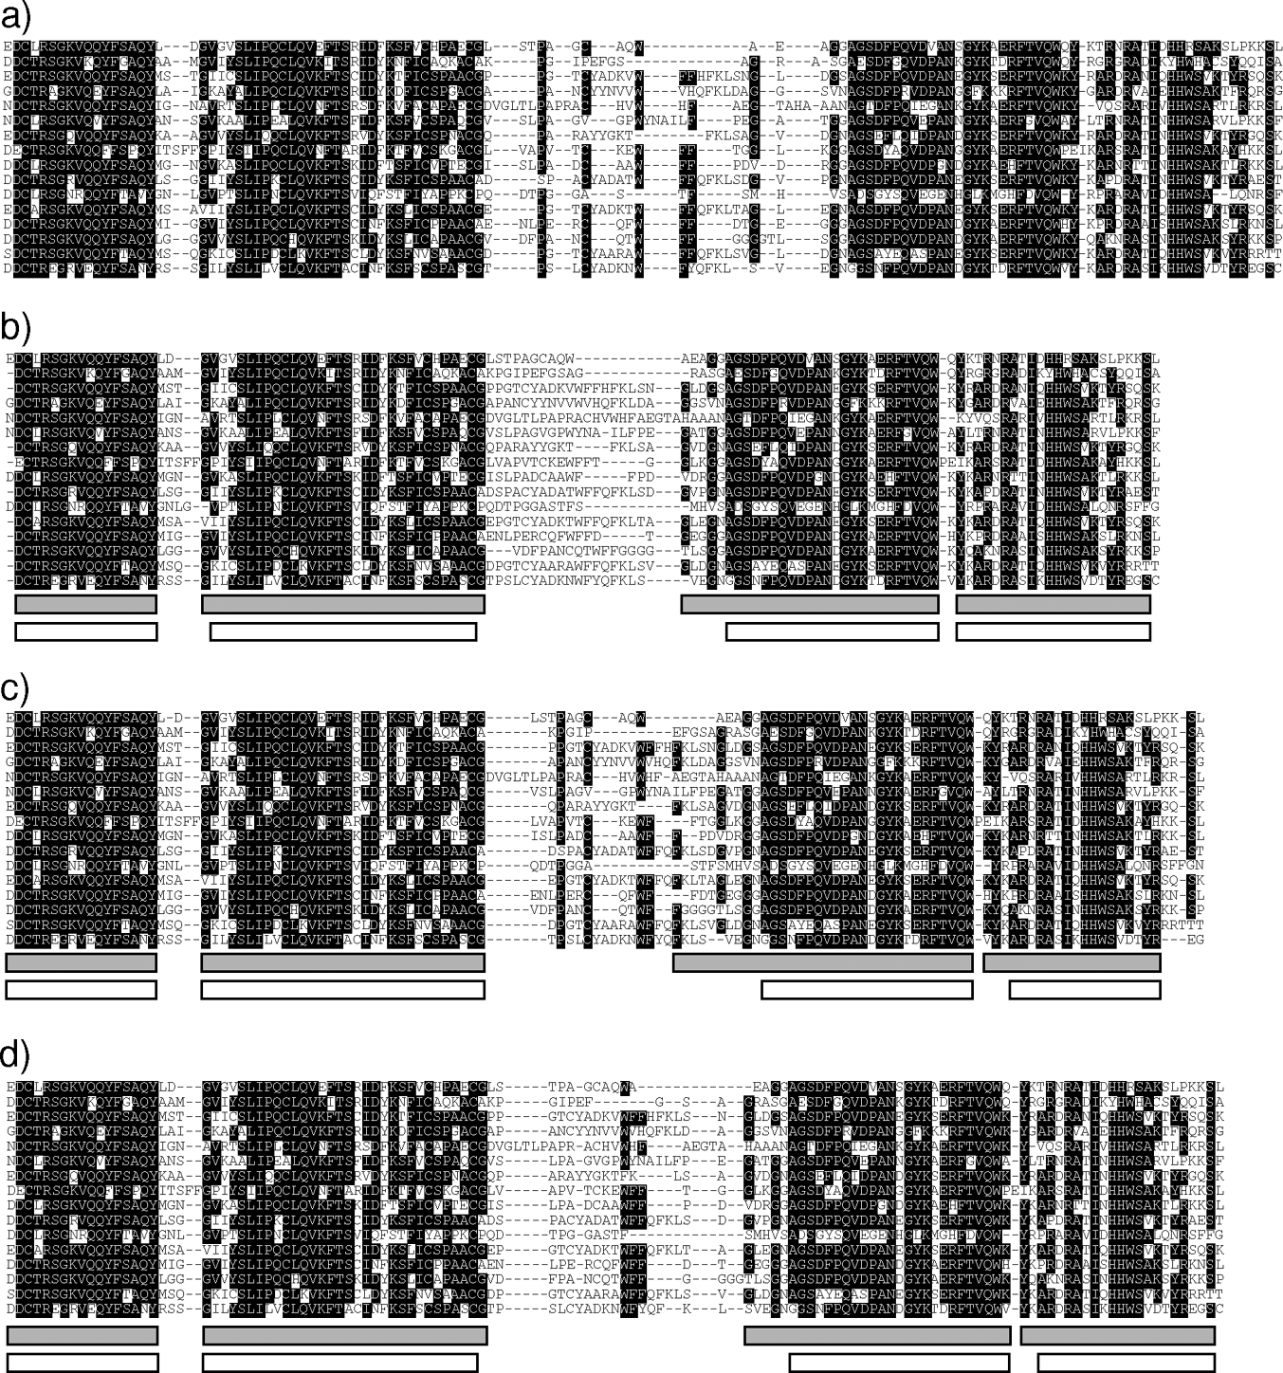
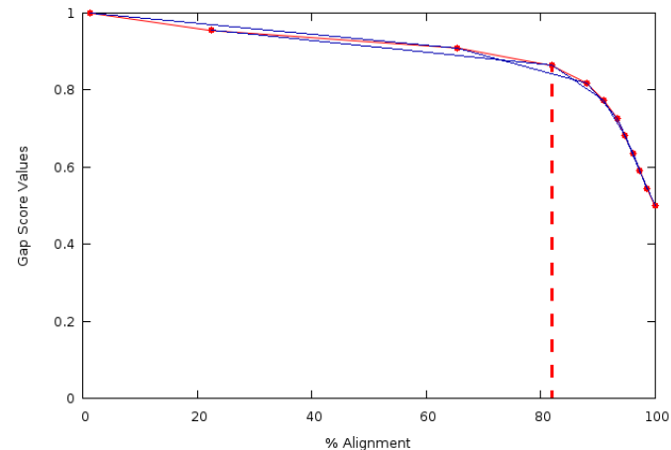
Gblocks
trimAl
419 citation by Google
Talavera G, Castresana J (2007) Improvement of Phylogenies after Removing Divergent and Ambiguously Aligned Blocks from Protein Sequence Alignments. Syst Biol 56: 564–577.
104 citation by Google
Capella-Gutiérrez S, Silla-Martínez JM, Gabaldón T (2009) trimAl: a tool for automated alignment trimming in large-scale phylogenetic analyses. Bioinformatics 25: 1972–1973.

Slide 31
Replication instead of filtering
gaps carry substantial phylogenetic signal, but are poorly exploited by most alignment and tree building programs;
Dessimoz C, Gil M: Phylogenetic assessment of alignments reveals neglected tree signal in gaps. Genome Biol 2010, 11(4):R37.
1aboA -NLFV-ALYDFVASGDNTLSITKGEKLRV-------LGYNHNG-----
1ycsB KGVIY-ALWDYEPQNDDELPMKEGDCMTI-------IHREDEDEI---
1pht -GYQYRALYDYKKEREEDIDLHLGDILTVNKGSLVALGFSDGQEARPE
1vie ---------DRVRKKSG--AAWQGQIVGW---------YCTNLTP---
1ihvA ------NFRVYYRDSRD--PVWKGPAKLL---------WKGEG-----
Original align.
1aboA -4445-66666676665455566655666-------6565544-----
1ycsB 33444-66666677775556666666666-------655554434---
1pht -54444776665656655666666555543444666666655445555
1vie ---------33344444--5555555555---------5555555---
1ihvA ------33344444444--4555554433---------33344-----
cons 133332444343443333444455433331111223332221111111
TCS scores
1aboA -NNNLLL ... -
1ycsB KGGGVVV ... -
1pht -GGGYYY ... E
1vie ------- ... -
1ihvA ------- ... -
TCS enrich align

Slide 32
Simulation: asymmetric = 2.0, ML
Notes:
Average Robinson-Foulds distance to reference tree with 16, 32 and 64 tips from the tree calculated with the MAFFT complete alignments, the same alignments after treatment with Gblock relaxed, Gblock stringent, trimAl gappyout, trimAl strictplus and TCS replicated. The asymmetric tree with three different divergence levels (0.5, 1.0 and 2.0) was used for the simulations with different alignment lengths (400, 800 and 1200). Trees were reconstructed by Maximum Likelihood.
Asym = 2

Slide 33
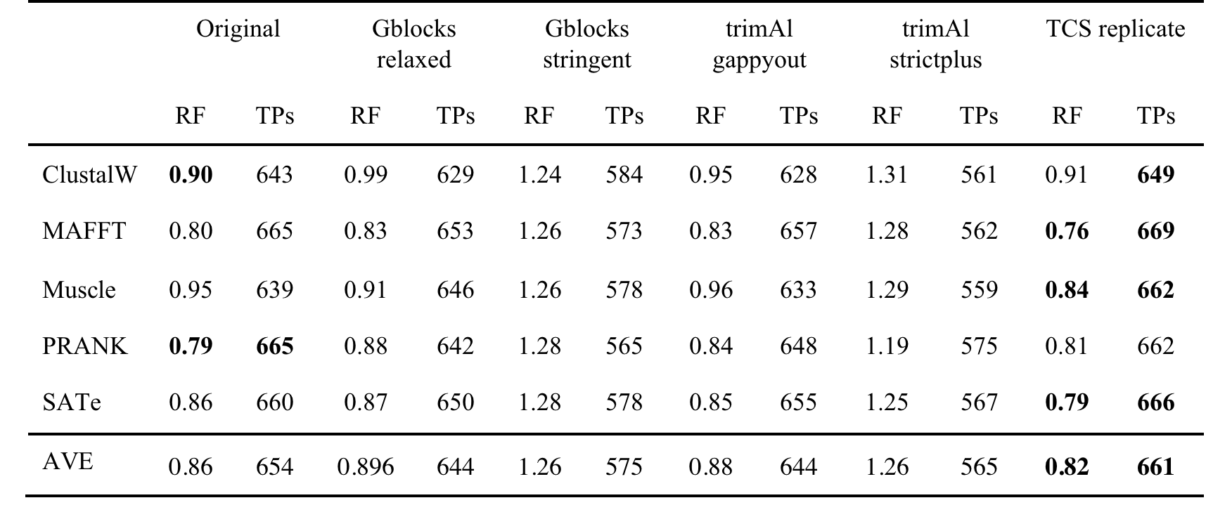
853 Yeast ToL
RF: average Robinson-Foulds distance respect to Yeast ToL.
TPs: the number of genes whose tree topology is identical with yeast ToL.

Slide 34
TCS Evaluation Libraries
TCS
t_coffee –seq <seq_file> -method proba_pair –out_lib <library> -lib_only
TCS_original
t_coffee –seq <seq_file> -method clustalw_pair, lalign_id_pair –out_lib <library> -lib_only
TCS_FM
t_coffee –seq <seq_file> -method kafft_msa,kalign_msa,muscle_msa –out_lib <library> -lib_only

Slide 35
TCS output
t_coffee –infile=<target_MSA> –evaluate –lib <library> -output \ sp_ascii,score_ascii,score_html,score_pdf,tcs_column_filter2,tcs_weighted,tcs_replicate100
sp_ascii is a format reporting the TCS score of every aligned pair (PairTCS) in the target MSA.
score_ascii reports the average score of every individual residue (ResidueTCS) along with the average score of every column (ColumnTCS) and the global MSA score (AlignmentTCS).
score_html score_ascii in html format with color code (Figure 4).
score_pdf will transfer score_html into pdf format.
tcs_column_filter2 outputs an MSA in which columns having ColumnTCS lower than 2 are removed.
tcs_weighted outputs an MSA in which columns are duplicated according to their ColumnTCS weight.
tcs_replicate100 outputs 100 replicate MSAs in which columns are randomly drawn according to their weights (ColumnTCS).

Slide 36


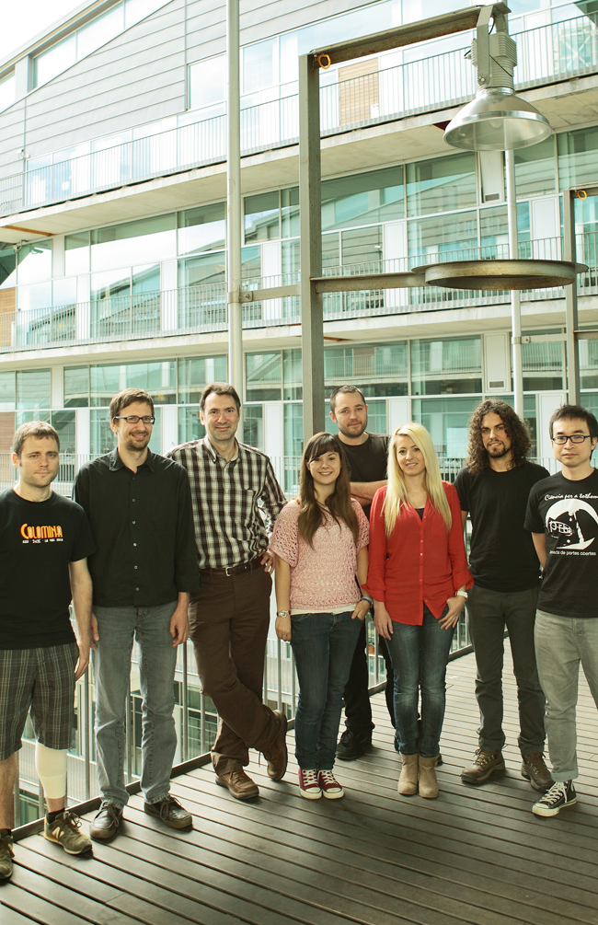



Acknowledgments
Paolo Di Tommaso CRG
Cedric Notredame
CRG
CB LAB
CRG
Notes:
I would thank all people involving in this project.
My supervisor also the owner of the old dog, Cedric
Paolo for developing web server. Salavdor points out the research direct of alignment uncertainty.
Thanks SMBE for traveling ground, La Caixa fellowships and CRG funding.

Slide 37

Acknowledgments
Toni Gabaldon,Mar Alba,Matthieu Louis,Romina Grarrido
Ana Maria Rojas Mendoza,Arcadi Navarro,Fernando Cores Prado

Slide 38


tcoffee.crg.cat/tcs
Thank You
sites.google.com/site/changjiaming
chang.jiaming@gmail.com

